Slide 1
True sons of the House
– Desire for God’s righteousness
Matt 5:1-12
07/08/16

Slide 2
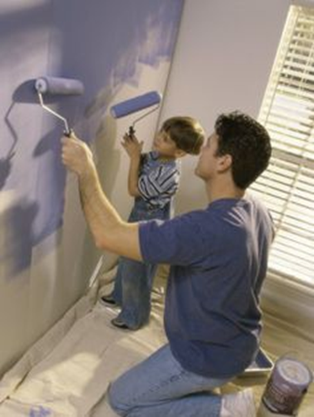
True sons of the House
We are called to be sons
Ownership
Covenantal relationship*
Vision (One–purpose/direction/character)
Godly nature (sons of God)
- Seeds which have to grow
- Hunger and thirst

Slide 3
True sons of the House
We are called to be sons
The heavenly God (Father) desires and
predestined us to be sons
The Son of God (Jesus) sacrificed Himself so we can be sons (co-heirs)
The Holy Spirit was given to prove that we are sons and lead us
The world is waiting for the appearance of the sons of God
We are born again into a new family (purpose)
Notes:
We are called to be more than “believers”

Slide 4
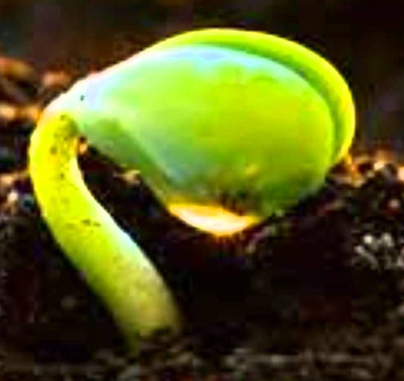
True sons of the House
We are called to be sons
Ownership
Covenantal relationship
Vision (One–purpose/direction/character)
Godly nature (sons of God)
- Seeds which have to grow
- Hunger and thirst
What do we hunger and thirst for?

Slide 5
What to hunger and thirst for? (Matt 5:1-12)
Blessed are the poor in spirit, For theirs is the kingdom of heaven.
Blessed are those who mourn, For they shall be comforted.
Blessed are the meek, For they shall inherit the earth.
Blessed are those who hunger
and thirst for righteousness, For they shall be filled.
Blessed are the merciful, For they shall obtain mercy.
Blessed are the pure in heart, For they shall see God.
Blessed are the peacemakers, For they shall be called sons of God
Blessed are those who are persecuted
for righteousness’ sake, For theirs is the kingdom of heaven.
“Blessed are you when they revile and persecute you, and say all kinds of evil against you falsely for My sake. Rejoice and be exceedingly glad, for great is your reward in heaven, for so they persecuted the prophets who were before you.
Notes:
Different Be-attitude → brings us a different result
Poor in spirit = I’m not there yet, desire to learn more, they will get to see and have the kingdom of heaven
Mourn = Compassion, desire to pray…. Answered prayer = comforted
Meek = Humility (He), Daniel Thank you, Sorry Pride (I)
What is hunger and thirst = crave for (desperate desire for)

Slide 6
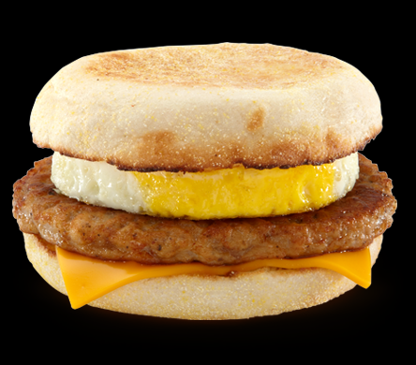

What to hunger and thirst for? (Matt 5:1-12)
Blessed are the poor in spirit, For theirs is the kingdom of heaven.
Blessed are those who mourn, For they shall be comforted.
Blessed are the meek, For they shall inherit the earth.
Blessed are those who hunger
and thirst for righteousness, For they shall be filled.
Blessed are the merciful, For they shall obtain mercy.
Blessed are the pure in heart, For they shall see God.
Blessed are the peacemakers, For they shall be called sons of God
Blessed are those who are persecuted
for righteousness’ sake, For theirs is the kingdom of heaven.
“Blessed are you when they revile and persecute you, and say all kinds of evil against you falsely for My sake. Rejoice and be exceedingly glad, for great is your reward in heaven, for so they persecuted the prophets who were before you.
Notes:
Different Be-attitude → brings us a different result
What is hunger and thirst = crave for (desperate desire for)

Slide 7
What is Righteousness?
Equitable (in character or act);
By implication innocent, holy (absolutely or relatively):
- just, meet, right (-eous).
Rightness of God (John G Lake)
Luke 6:21,25
Blessed are you who hunger now, For you shall be filled.
Woe to you who are full, For you shall hunger.
Mat 6:33 But seek first the kingdom of God and his righteousness, and all these things will be added to you.
(eat, drink, clothes – what the Gentiles seek)
Notes:
Being right by God’s standard. (not men’s opinion)
For they shall be filled… Filled spiritually but also what the Gentile seek, eat drink clothes, the basic needs are met)

Slide 8
How do we gain righteousness? (Rom 4:20-25)
God counted Abraham as righteous (Believe & Do)
No unbelief made him waver concerning the promise of God, but he grew strong in his faith as he gave glory to God, fully convinced that God was able to do what he had promised. That is why his faith was "counted to him as righteousness."
But the words "it was counted to him" were not written for his sake alone, but for ours also. It will be counted to us who believe in him who raised from the dead Jesus our Lord, who was delivered up for our trespasses and raised for our justification.

Slide 9
How do we gain righteousness? (Rom 6)
Present (obey):
V13 - Ourselves to God
V13 - Our members as instruments for righteousness.
V16 - Ourselves as slaves of obedience (not sin), which leads to righteousness.
V18 - Ourselves as slaves of righteousness.
V19 - Our members as slaves to righteousness leading to sanctification.
Notes:
Grace talk about perishing, how do we die, we surrender. We Present our bodies
Our members (Open my eyes Lord, the member of our bodies are made to feel God, see, hear, feel, smell)
ACTIVATE! DECLARE

Slide 10
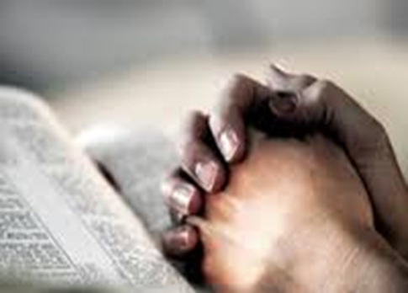

Rightness of God in our lives…
A) Relationship with God
i. Spirit
Born again – baptisms.
ii. Soul
Renew mind. Resurrection life = crucify + come alive
iii. Body
Daily presenting
Resurrection from the dead
Glorious body (personal)
Glorious Church (bride of Christ)
Notes:
True sons = true relationship. Rightness of God can be in money, affairs, business etc.
Once mind is controlled, Emotions and will under subjection.
Think of something scary, fear…. Sad, cry etc.
Old thoughts go away. New thought come in. New batteries.
How we think we will act.
Cold and hot.

Slide 11
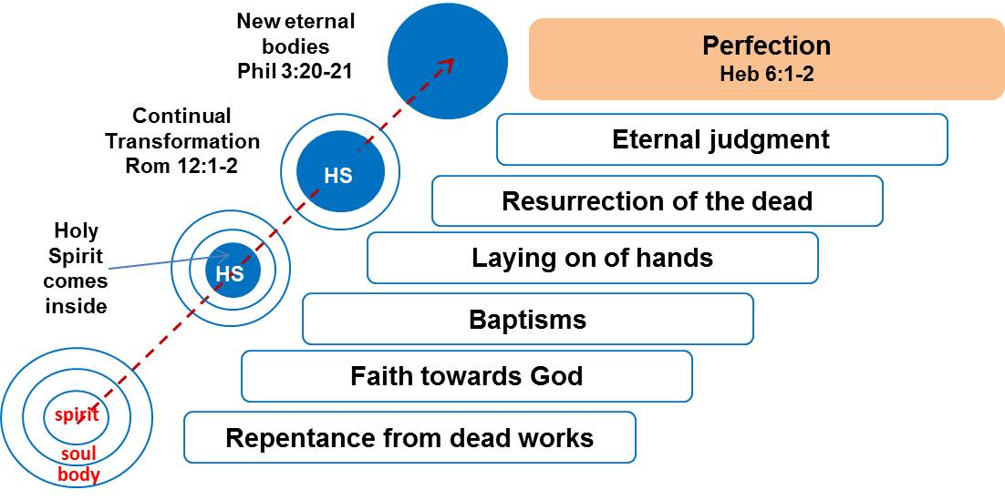
Rightness of God in our lives…
Notes:
True sons = true relationship

Slide 12
Rightness of God in our lives…
Covenantal relationship: Bought with the blood of Christ.
B) Relationship with spiritual authority (father of the house)
e.g. Abraham & 318 armed men. *Born & trained
Gen 14:1-24 – One authority, one command, one goal
¹⁴And when Abram heard that his brother was taken captive, he armed his trained servants, born in his own house, 318, and pursued them unto Dan.
Notes:
*Judas spirit (I am here for my profit).

Slide 13
Rightness of God in our lives…
Covenantal relationship: Bought with the blood of Christ.
C) Relationship with one another
Same work (battle):
Everyone plays a part in the Kingdom
Same goal/reward/destiny (Lot rescued)
Go Towards Our Common Destiny As ONE
- Same miracles
Unity → Jesus appeared (Melchizedek)
Notes:
Everyone played a part…. screws, planks, doors
One person cannot do it all but a body of people (The Church)
That’s why every member of the Body of Christ must rise.

Slide 14
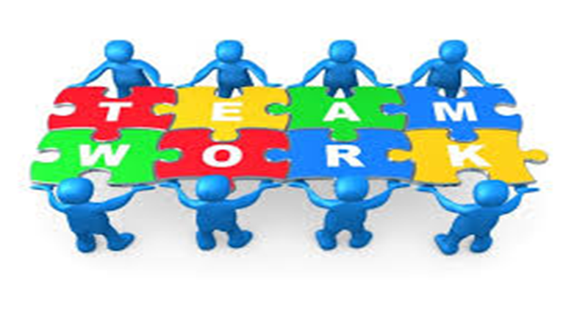
Conclusion
For sons of God to mature, they must hunger and thirst for God’s righteousness (Be right by His standard).
The rightness of God must be in every aspect of our lives.
In our relationship with Him and with one another.
In this season of change, a time of great significance and opportunity, everyone will need to rise and play a part as One towards a common destiny.
Notes:
No under current.
No bitterness and offenses…
Keep focus on te goal!
*Sing, gather together as one… evangel church

